Slide 1

Model Distillation for Plant Disease Classification
Applied Machine Learning
Minh Tran, Leo Ho

Slide 2

Why Plant Disease Classification Matters?
Labeling large datasets is time-consuming and resource-intensive
We need models that are
Accurate
Lightweight
Efficient with limited labeled data
Early plant disease detection = critical for global food supply
Goal: Enable real-time classification on mobile and edge devices

Slide 3
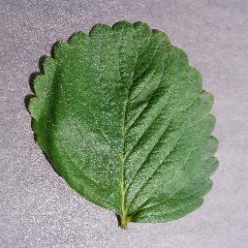
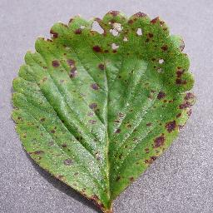
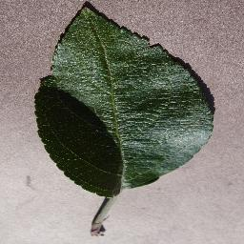
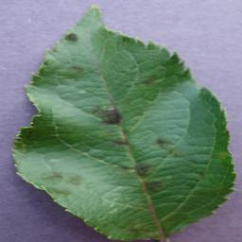
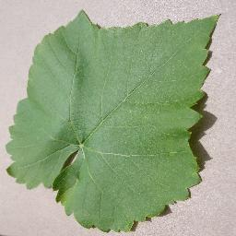
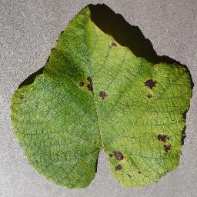
PlantVillage Dataset
Sources: 50K+ healthy and unhealthy leaf images across 38 categories (species/disease)
Collection Methodology
Images collected in controlled laboratory setting
Leaves placed on uniform backgrounds for consistency
RBG images at consistent resolution
Characteristics
Public, clean, balanced dataset
Train-Val-Test split: 80%-10%-10%
Mohanty SP, Hughes DP, Salathé M. Using Deep Learning for Image-Based Plant Disease Detection. Front Plant Sci. 2016 Sep 22;7:1419. doi: 10.3389/fpls.2016.01419. PMID: 27713752; PMCID: PMC5032846.
Healthy
Unhealthy

Slide 4
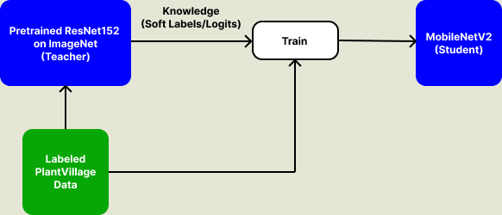
Model Distillation Workflow

Slide 5
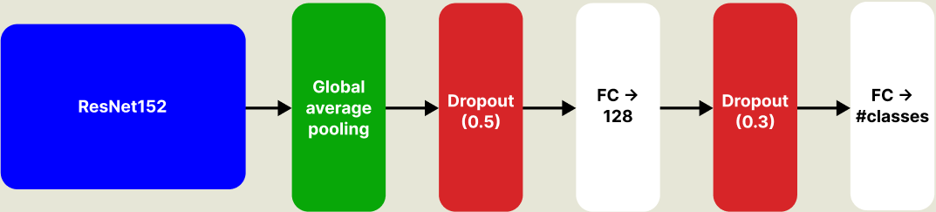
Teacher Model

Slide 6
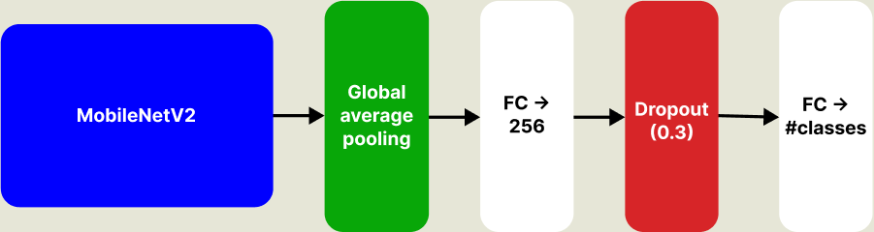
Student Model

Slide 7
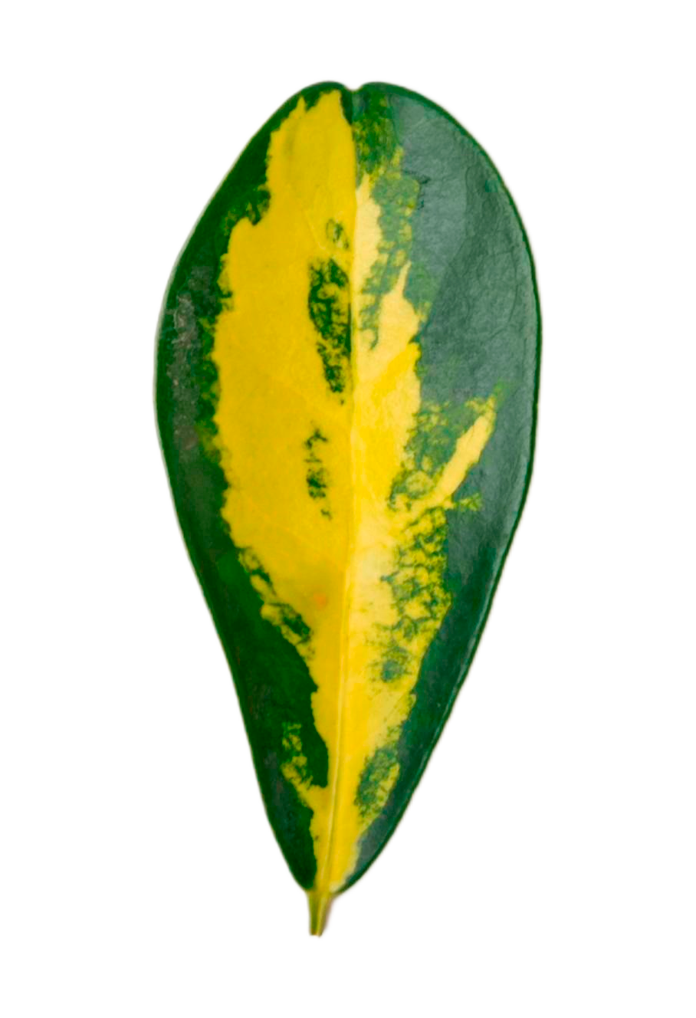
Accuracy & Inference Time Comparison
Accuracy & Speed Matter
Model | Good Enough for Mobile? | Test Accuracy (%) | Inference Time (s/image)
Pretrained ResNet152 (Teacher) | ❌ | 97.24 | 7.1
MobileNetV2 (Distilled) | ✅ | 88.02 | 2.4
MobileNetV2 (Baseline) | ✅ | 82.77 | 3.5

Slide 8
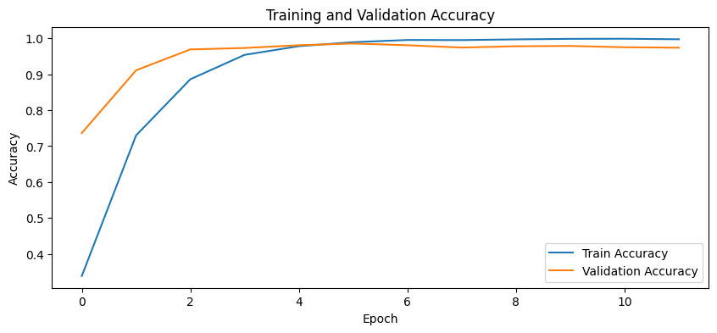
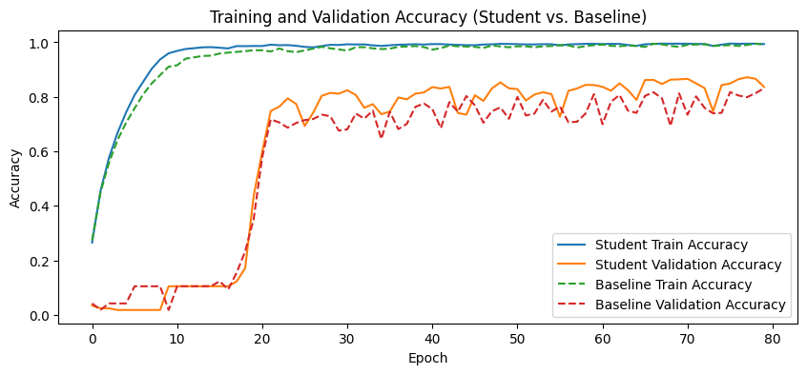
Validation Accuracy Comparison
Resnet152 (Teacher)
Distilled MobileNetV2 vs. Baseline MobileNetV2

Slide 9
Distilled MobileNetV2 vs. Baseline MobileNetV2
Distilled > Baseline
Student model outperforms baseline MobileNetV2 in both training and validation
Learns from Pretrained Teacher
ResNet152 was pretrained on ImageNet, so the student inherits richer features and generalizes better
Faster & Smoother Convergence
Student model outperforms baseline MobileNetV2 in both training and validation.

Slide 10
Summary & Impact
Efficient Knowledge Transfer
Less Labeling, More Learning
The student model successfully mimics the performance of a deep, complex teacher model, preserving high classification accuracy while significantly reducing model size
By training on soft labels generated by the teacher, the student model learns nuanced patterns without requiring additional manual labeling efforts
Deployment-Ready Models
Scalable Agricultural AI
The distilled MobiletV2 offers fast inference and compact architecture, making it ideal for deployment on real-time edge devices in agricultural settings
This approach demonstrates how ML can scale into real-world tools, empowering farmers with accessible plant disease detection systems

Slide 11

Thanks
Do you have any questions?

